Slide 1
Algorithm Analysis (Big O)
www.hndit.com
Lecture 9

Slide 2
Complexity
www.hndit.com
In examining algorithm efficiency we must understand the idea of complexity
  Space complexity
  Time Complexity

Slide 3
Space Complexity
www.hndit.com
When memory was expensive we focused on making programs as space efficient as possible and developed schemes to make memory appear larger than it really was (virtual memory and memory paging schemes)
Space complexity is still important in the field of embedded computing (hand held computer based equipment like cell phones, palm devices, etc)

Slide 4
Time Complexity
www.hndit.com
Is the algorithm “fast enough” for my needs
How much longer will the algorithm take if I increase the amount of data it must process
Given a set of algorithms that accomplish the same thing, which is the right one to choose

Slide 5
Algorithm Efficiency
www.hndit.com
a measure of the amount of resources consumed in solving a problem of size n
  time
  space
Benchmarking: implement algorithm,
  run with some specific input and measure time taken
  better for comparing performance of processors than for comparing performance of algorithms
Big Oh (asymptotic analysis)
  associates n, the problem size,
  with t, the processing time required to solve the problem

Slide 6
Cases to examine
www.hndit.com
Best case
  if the algorithm is executed, the fewest number of instructions are executed
Average case
  executing the algorithm produces path lengths that will on average be the same
Worst case
  executing the algorithm produces path lengths that are always a maximum

Slide 7
Algorithm Analysis
www.hndit.com
Analyze in terms of Primitive Operations:
  e.g.,
    An addition = 1 operation
    Assignment = 1 operation
    Calling a method or returning from a method = 1 operation
    Index in an array = 1 operation
    Comparison = 1 operation
Analysis: count the number of primitive operations executed by the algorithm

Slide 8
Frequency Count
www.hndit.com
examine a piece of code and predict the number of instructions to be executed
e.g.
for each instruction predict how many times each will be encountered as the code runs
Inst #
1
2
3
Code
for (int i=0; i< n ; i++)
{ cout << i;
p = p + i;
}
F.C.
n+1
n
n
____
3n+1
totaling the counts produces the F.C. (frequency count)

Slide 9
Another example
www.hndit.com
Inst #
1
2
3
4
Code
for (int i=0; i< n ; i++)
for int j=0 ; j < n; j++)
{ cout << i;
p = p + i;
}
F.C.
n+1
n(n+1)
n*n
n*n
F.C.
n+1
n²+n
n²
n²
____
3n²+2n+1
discarding constant terms produces : 3n²+2n
clearing coefficients : n²+n
picking the most significant term: n²
Big O = O(n²)

Slide 10
Analyzing Running Time
www.hndit.com
1. n = read input from user
2. sum = 0
3. i = 0
4. while i < n
5. number = read input from user
6. sum = sum + number
7. i = i + 1
8. mean = sum / n
Statement Number of times executed
1 1
2 1
3 1
4 n+1
5 n
6 n
7 n
8 1
The computing time for this algorithm in terms on input size n is: T(n) = 4n + 5.

Slide 11
How many foos?
www.hndit.com
for (j = 0; j < N; ++j) {
for (k = 0; k < j; ++k) {
foo( );
}
}
for (j = 0; j < N; ++j) {
for (k = 0; k < M; ++k) {
foo( );
}
}
N(N + 1)/2
NM

Slide 12
What is Big O
www.hndit.com
Big O
  rate at which algorithm performance degrades as a function of the amount of data it is asked to handle
For example:
  O(n) -> performance degrades at a linear rate O(n²) -> quadratic degradation

Slide 13
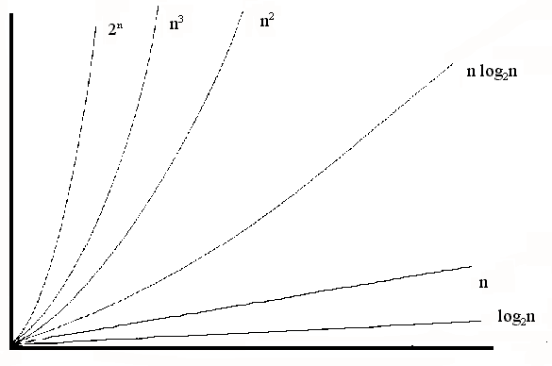
Common growth rates
www.hndit.com

Slide 14
Big Oh - Formal Definition
www.hndit.com
Definition of "big oh":
f(n)=O(g(n)), iff there exist constants c and n₀ such that: f(n) <= c ∗ g(n) for all n>=n₀
Thus, g(n) is an upper bound on f(n)
Note:
f(n) = O(g(n))
is NOT the same as
O(g(n)) = f(n)
The '=' is not the usual mathematical operator "=" (it is not reflexive)

Slide 15
big Oh
www.hndit.com
measures an algorithm’s growth rate
  how fast does the time required for an algorithm to execute increase as the size of the problem increases?
is an intrinsic property of the algorithm
  independent of particular machine or code
based on number of instructions executed
for some algorithms is data-dependent
meaningful for “large” problem sizes

Slide 16
Iterative Power function
www.hndit.com
double IterPow (double X, int N) {
double Result = 1;
while (N > 0) {
Result *= X;
N--;
{
return Result;
}
1
n+1
n
n
1
Total instruction count: 3n+3
critical region
algorithm's computing time (t) as a function of n is: 3n + 3
t is on the order of f(n) - O[f(n)]
O[3n + 3] is n

Slide 17
www.hndit.com
Find the maximum element of an array.
1. int findMax(int *A, int n) {
2. int currentMax = A[0]
3. for (int i= 1 ; i < n; i++)
4. if (currentMax < A[i] )
5. currentMax = A[i];
6. return currentMax;
}
How many operations ?
Declaration: no time
Line 2: 2 count
Line 6: 1 count
Lines 4 and 5: 4 counts * the number of times the loop is iterated.
Line 3: 1 + n + n-1 (because loop is iterated n – 1 times).
Total: 2 + 1 +n + (n-1) + 4*(n-1) + 1= 6n - 1

Slide 18
Common big Ohs
www.hndit.com
constant O(1)
logarithmic O(log₂ N)
linear O(N)
n log n O(N log₂ N)
quadratic O(N²)
cubic O(N³)
exponential O(2^{N})

Slide 19
Comparing Growth Rates
www.hndit.com
2^{n}
n²
n log₂ n
n
T(n)
log₂ n
Problem Size

Slide 20
Uses of big Oh
www.hndit.com
compare algorithms which perform the same function
  search algorithms
  sorting algorithms
comparing data structures for an ADT
  each operation is an algorithm and has a big Oh
  data structure chosen affects big Oh of the ADT's operations

Slide 21
Comparing algorithms
www.hndit.com
Sequential search
growth rate is O(n)
average number of comparisons done is n/2
Binary search
growth rate is O(log₂ n)
average number of comparisons done is 2((log₂ n) -1)
n n/2 2((log₂ n)-1)
100 50 12
500 250 16
1000 500 18
5000 2500 24

Slide 22
Common time complexities
www.hndit.com
BETTER
WORSE
O(1) constant time
O(log n) log time
O(n) linear time
O(n log n) log linear time
O(n²) quadratic time
O(n³) cubic time
O(2^{n}) exponential time

